Slide 1
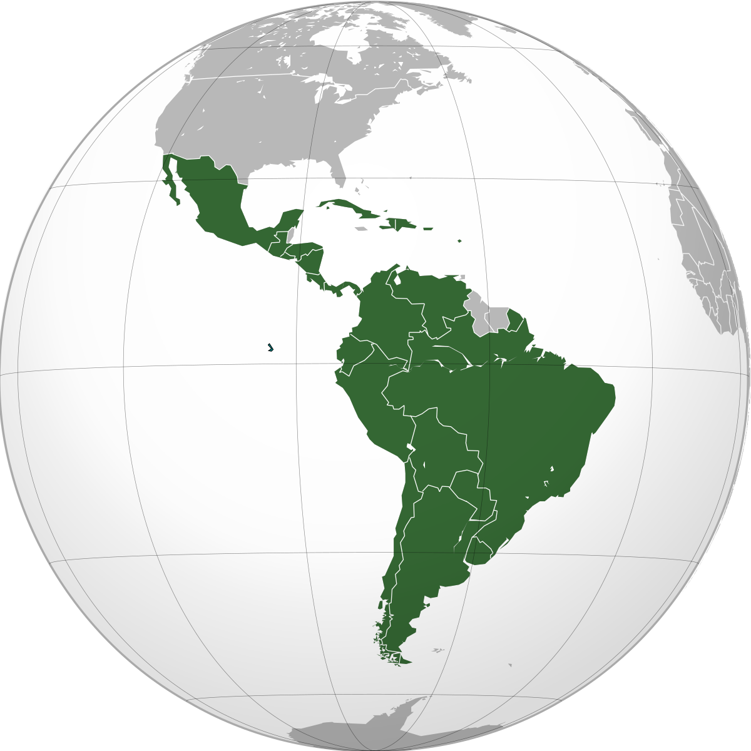
Jan. 31- Feb. 3

Slide 2
Latin America

Slide 3
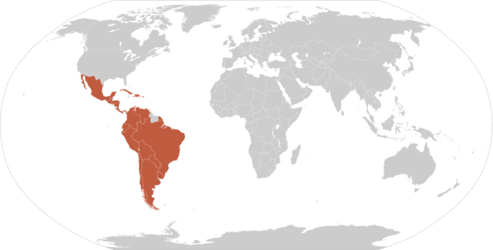
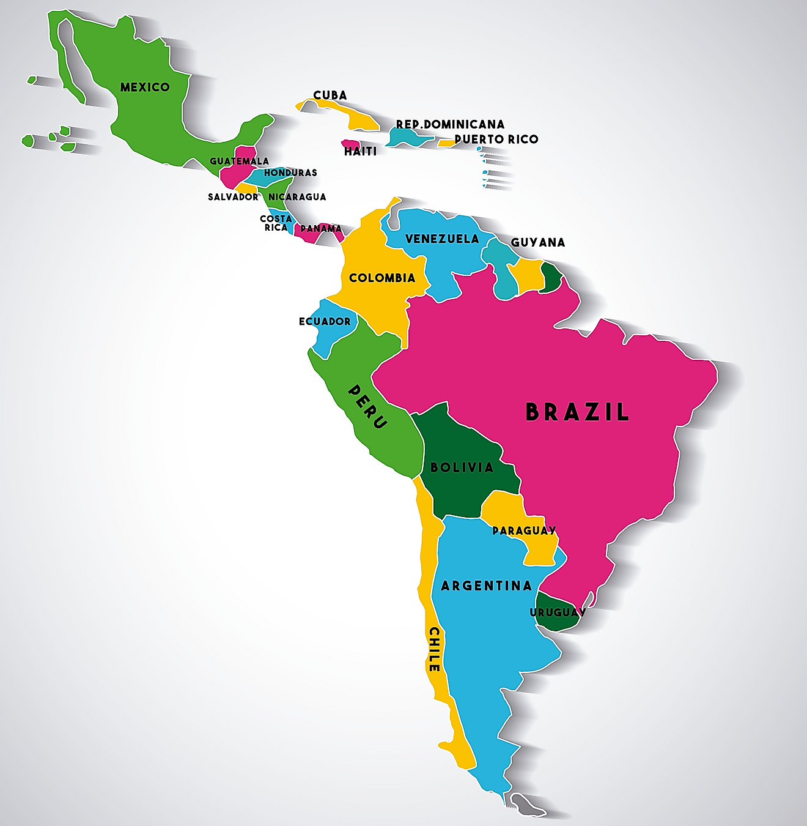
Latin America is generally understood to consist of the entire continent of South America in addition to Mexico, Central America, and the islands of the Caribbean whose inhabitants speak a Romance language. The peoples of this large area shared the experience of conquest and colonization by theSpaniards and Portuguese from the late 15th through the 18th century as well as movements of independence from Spain and Portugal in the early 19th century. Even since independence, many of the various nations have experienced similar trends, and they have some awareness of a common heritage.
www.britannica.com/place/Latin-America

Slide 4

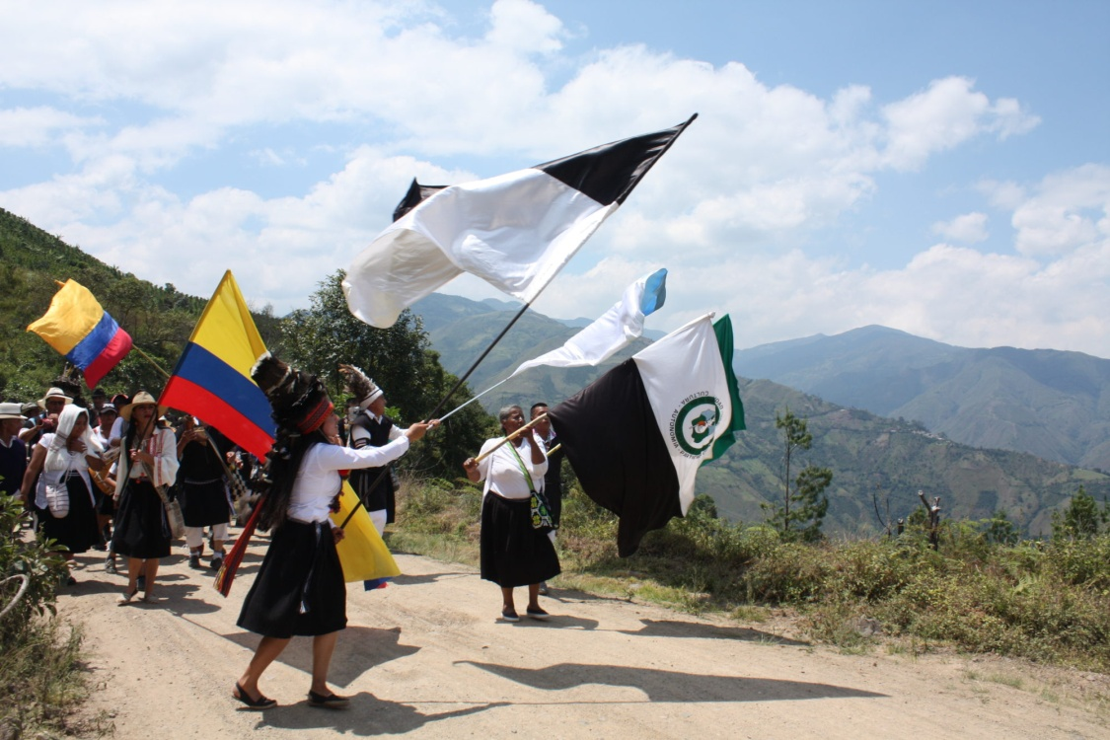
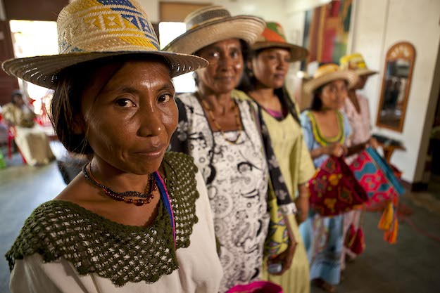
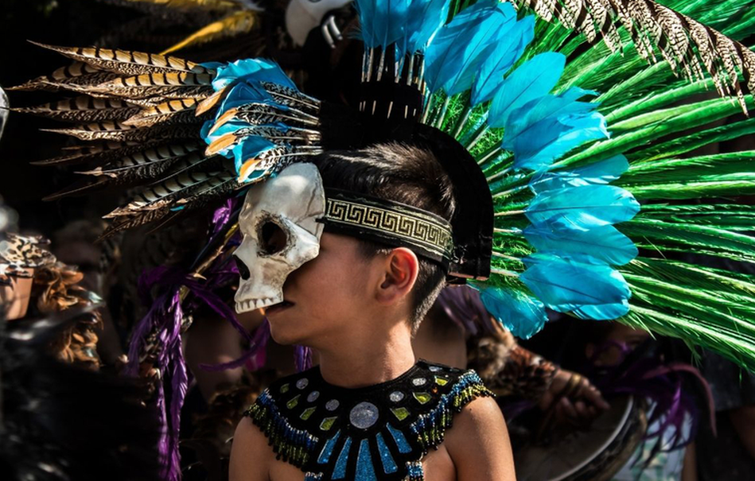

Slide 5
Standards ( January 17-20 )
SS6H1 Explain conflict and change in Latin America.
b. Describe the influence of the Spanish and the Portuguese on the language and religions of Latin America.
d. Explain the impact of poverty, the war on drugs, and migration to the United States on Latin America.
SS6G2 Explain the impact of environmental issues in Latin America.
Explain the causes and effects of air pollution in Mexico City, Mexico.
Explain the environmental issue of destruction of the rain forest in Brazil.
SS6E2 Give examples of how voluntary trade benefits buyers and sellers in Latin America.
a. Explain how specialization encourages trade between countries.
b. Compare and contrast different types of trade barriers, such as tariffs, quotas, and embargos.

Slide 6
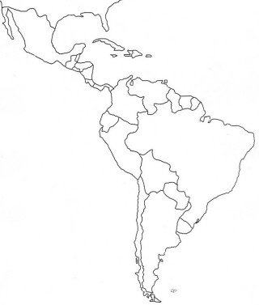
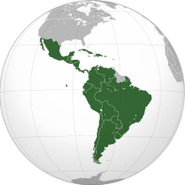
8
B
Latin America
1
M
D
M
2
C
A
3
e
5
4
H
G
F
G
7
H
K
6
H

Slide 7

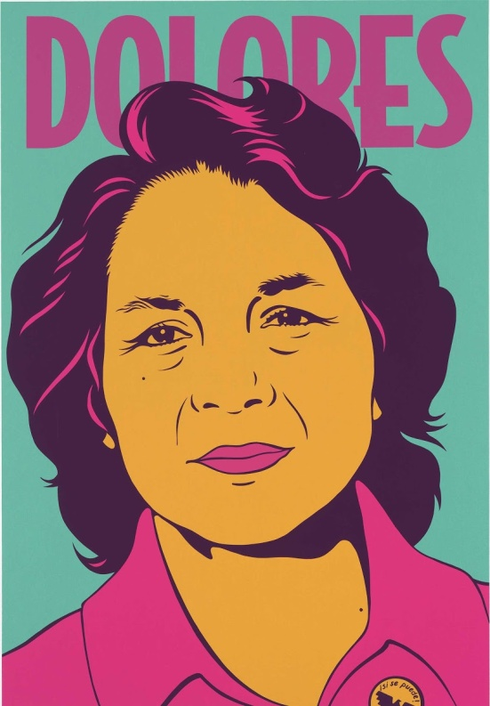
Students will working on their Social Studies Project.
This project will have two parts (Martin Luther King and Latin America Leaders). Jan.20 – Feb.22

Slide 8
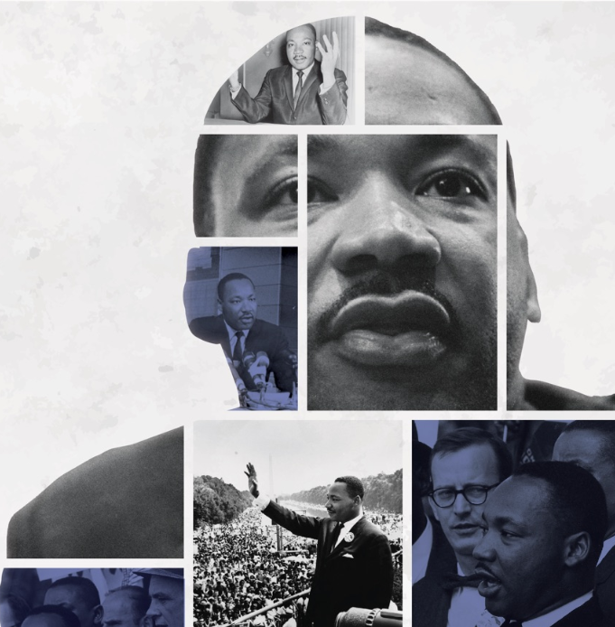
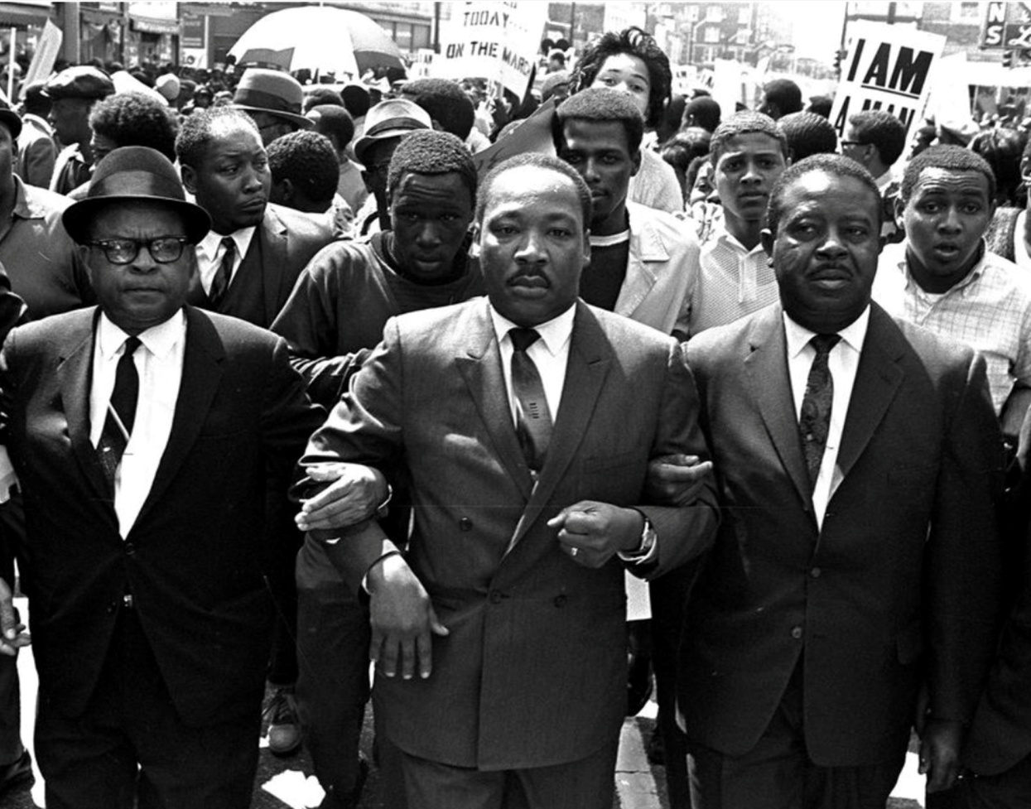
Monday, January 16
No School: Martin Luther King Holiday

Slide 9

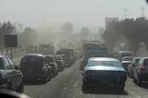
Air Pollution in Mexico City
Mexico City was once named as the world’s most polluted city in the world, but according to IQAir, a Swiss company which keeps track of the air quality of cities around the globe, Mexico City has now dropped down to the 917th most polluted city in the world in 2021. Though its concentration of airborne particles (PM 2.5) still currently exceeds the guideline of the World Health Organization (WHO), yet the colossal improvement is undoubtable. What has been done to successfully reduce air pollution in Mexico City? And what lessons can other cities learn from it?

Slide 10
Tuesday, January 17
Standard:
SS6G2 Explain the impact of environmental issues in Latin America.
SS6H1.b Explain conflict and change in Latin America.
Learning Target: Explain the impact of environmental issues (air pollution and destruction of rain forest) in Latin America; Explain conflict and change in Latin America (Describe the influence of the Spanish and the Portuguese on the language and religions of Latin America).
Warm-up: video (destruction of rainforest)
Work Session: Cloze Notes (Brain Wrinkles); Textbook p.346, 401; Environmental issues of Latin America (air pollution and destruction of rain forest). Spain/Portugal colonization of Latin America (language and Religion); TB p.322-323
Closing: Think-Pair-Share
Reminders: Quiz on Wednesday will cover G1,G2, H1b

Slide 11
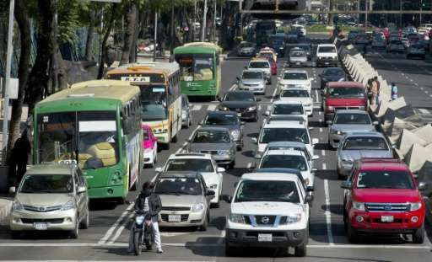
Click for video link
Air pollution smothers industrial cities across Mexico

Slide 12
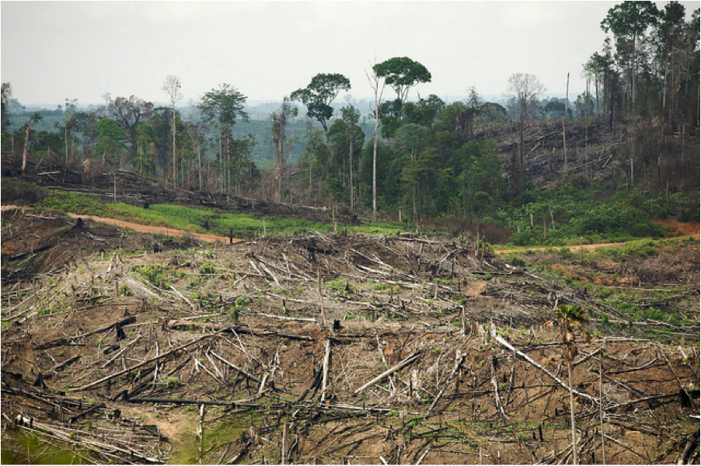
Destruction of the rain forest in Brazil
Humans are the main cause of rainforest destruction. We are cutting down rainforests for many reasons, including:
wood for both timber and making fires;
agriculture for both small and large farms;
land for poor farmers who don’t have anywhere else to live;
grazing land for cattle;
pulp for making paper;
road construction; and
extraction of minerals and energy.
An estimated 18 million acres (7.3 million hectares) of forest — roughly the size of Panama

Slide 13
Wednesday, January 18
Standard:
SS6G2 Explain the impact of environmental issues in Latin America.
SS6H1.b Explain conflict and change in Latin America.
Learning Target: Explain the impact of environmental issues (air pollution and destruction of rain forest) in Latin America; Explain conflict and change in Latin America (Describe the influence of the Spanish and the Portuguese on the language and religions of Latin America).
Warm-up: video (religions of Latin America)
Work Session: Cloze Notes (Brain Wrinkles); Textbook p.346, 401; Environmental issues of Latin America (air pollution and destruction of rain forest). Spain/Portugal colonization of Latin America (language and Religion); TB p.322-323
Closing: TOD
Reminders: Quiz will cover G1,G2, H1b

Slide 14
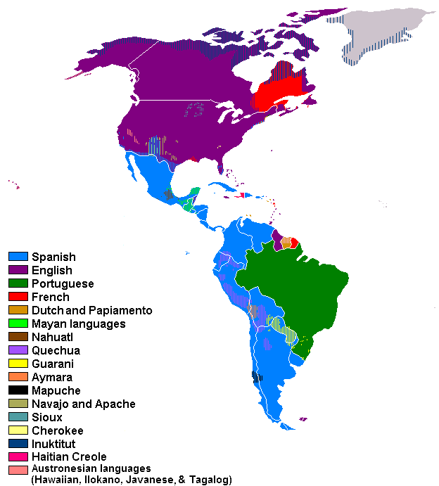
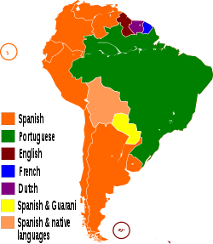
Languages of Latin America:
1) Spanish 2) Portuguese 3) English 4) German 5) Italian

Slide 15

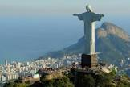

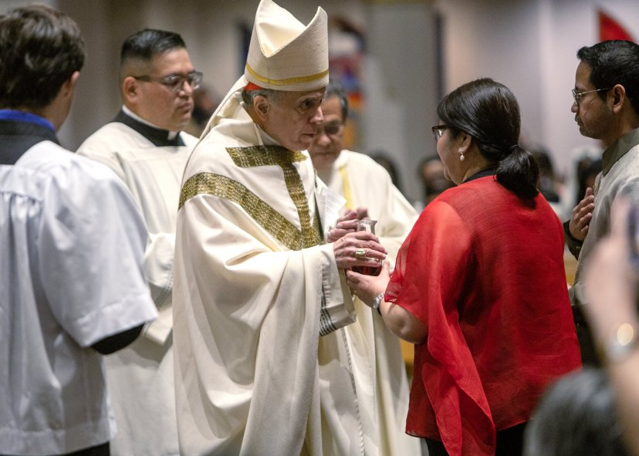

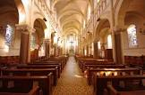
The majority of Latin Americans are Christians (90%), mostly Roman Catholics.

Slide 16
Thursday, January 19
Standard:
SS6H1.d Explain conflict and change in Latin America. d. Explain the impact of poverty, the war on drugs, and migration to the United States on Latin America.
SS6E2 Give examples of how voluntary trade benefits buyers and sellers in Latin America.
a. Explain how specialization encourages trade between countries.
b. Compare and contrast different types of trade barriers, such as tariffs, quotas, and embargos.
Learning Target: Explain the impact of poverty, the war on drugs, and migration to the United States on Latin America
Warm-up: Video (poverty in Latin America, the war on drugs, migration to the US)
Work Session: Cloze Notes (Brain Wrinkles); Textbook p. 329-333; poverty; war on drugs and migration to US.
Economics: specialization encourages trade, trade barriers.
Closing: Student Summarize
Reminders:

Slide 17
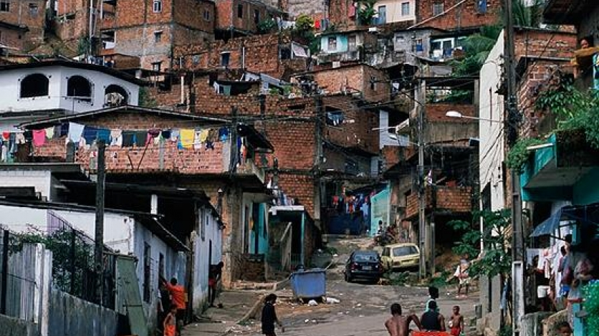
The Social Panorama 2022 report projects that 201 million people (32.1% of the region’s total population) live in situations of poverty, with 82 million (13.1%) of them in extreme poverty. The regional organization calls for urgently addressing the silent crisis in education to avert the risk of a lost generation.

Slide 18
Friday, January 20
Standard:
SS6H1.d Explain conflict and change in Latin America. d. Explain the impact of poverty, the war on drugs, and migration to the United States on Latin America.
SS6E2 Give examples of how voluntary trade benefits buyers and sellers in Latin America.
a. Explain how specialization encourages trade between countries.
b. Compare and contrast different types of trade barriers, such as tariffs, quotas, and embargos.
Learning Target: Explain the impact of poverty, the war on drugs, and migration to the United States on Latin America
Warm-up: Practice Latin America Map with Partner
Work Session: Cloze Notes (Brain Wrinkles); Textbook p. 329-333; poverty; war on drugs and migration to US.
Economics: specialization encourages trade, trade barriers; Stations
Closing: Think-Pair- Share
Reminders:

Slide 19
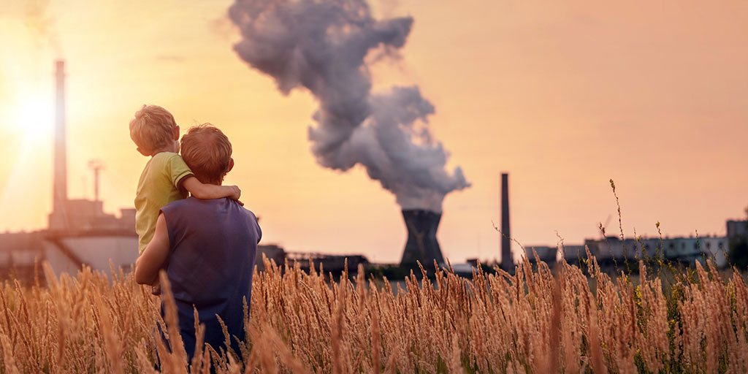
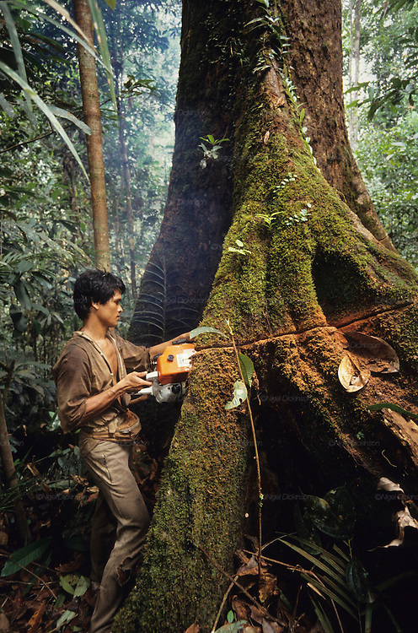

Slide 20
Standards
SS6G1 Locate selected features of Latin America.
Locate on a world and regional political-physical map: Amazon River, Amazon Rainforest, Caribbean Sea, Gulf of Mexico, Atlantic Ocean, Pacific Ocean, Panama Canal, Andes Mountains, Sierra Madre Mountains, and Atacama Desert.
b. Locate on a world and regional political-physical map the countries of Brazil, Chile,
Colombia, Cuba, Mexico, and Panama.
SS6G2 Explain the impact of environmental issues in Latin America.
Explain the causes and effects of air pollution in Mexico City, Mexico.
Explain the environmental issue of destruction of the rain forest in Brazil.
SS6H1 Explain conflict and change in Latin America.
b. Describe the influence of the Spanish and the Portuguese on the language and religions of Latin America.
d. Explain the impact of poverty, the war on drugs, and migration to the United States on Latin America.

Slide 21
Questions:
What type of environmental issue does Mexico City face?
What is the biggest cause for this pollution?
What physical features of Mexico City add to the problem?
What measures are the Government putting into place to help solve this problem?
Why is the rainforest important?
List some reasons why the rainforest is being destroyed?
How doe this impact the environment and the world?

